Slide 1
Spring Cloud Stream- Config Server
Mostafa Rastgar
june 2019

Slide 2
Agenda
Spring Cloud Stream
Cross-Cutting Concern Patterns
Spring Cloud Config

Slide 3
Spring Cloud Stream
Spring Cloud Stream is a framework built on top of Spring Boot and Spring Integration that helps in creating event-driven or message-driven microservices
Main Concepts
EnableBinding — configures the application to bind the channels INPUT and OUTPUT defined within the interface Processor
Bindings — a collection of interfaces that identify the input and output channels declaratively
Binder — messaging-middleware implementation such as Kafka or RabbitMQ
MessageChannel — Defines methods for sending messages
ServiceActivator — Indicates that a method is capable of handling a message or message payload

Slide 4
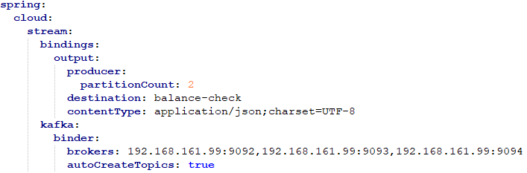
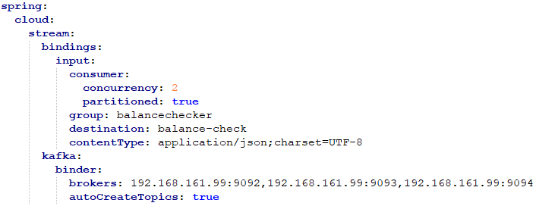
Spring Cloud Stream
Producer Configs:
Consumer Configs:

Slide 5
Cross-Cutting Concern Patterns
Service Discovery Pattern
Problem:
Each service URL has to be remembered by the consumer and become tightly coupled
So how does the consumer or router know all the available service instances and locations
Solution:
A service registry needs to be created which will keep the metadata of each producer service
The consumer or router should query the registry and find out the location of the service
There are two types of service discovery: client-side and server-side
An example of client-side discovery is Netflix Eureka
an example of server-side discovery is AWS ALB

Slide 6
Cross-Cutting Concern Patterns
Circuit Breaker Pattern
Problem:
What will happen if downstream service is down?
First, the request will keep going to the down service, exhausting network resources and slowing performance
Second, How do we avoid cascading service failures and handle failures gracefully
Solution:
The consumer should invoke a remote service via a proxy that behaves in a similar fashion to an electrical circuit breaker
When the number of consecutive failures crosses a threshold, the circuit breaker trips
After the timeout expires the circuit breaker allows a limited number of test requests to pass through
If those requests succeed, the circuit breaker resumes normal operation
Netflix Hystrix is a good implementation of the circuit breaker pattern. It also helps you to define a fallback mechanism which can be used when the circuit breaker trips

Slide 7
Cross-Cutting Concern Patterns
Deployment Pattern
Problem
With microservice architecture, one application can have many microservices
If we stop all the services then deploy an enhanced version, the downtime will be huge and can impact the business
Also, the rollback will be a nightmare
Solution:
Blue-Green
Canary

Slide 8
Cross-Cutting Concern Patterns
External Configuration
Problem:
A service typically calls other services and databases as well
For each environment like dev, QA, prod, the endpoint URL or some configuration properties might be different
A change in any of those properties might require a re-build and re-deploy of the service
How do we avoid code modification for configuration changes?
Solution:
Externalize all the configuration, including endpoint URLs and credentials
The application should load them either at startup or on the fly
Spring Cloud config server provides the option to externalize the properties to GitHub and load them as environment properties
These can be accessed by the application on startup or can be refreshed without a server restart

Slide 9
Spring Cloud Config
The applications settings can be moved to an external place so that applications will be easily configurable and can even change their settings
To do this, a configuration server should be created
Just add @EnableConfigServer on the class level
Clients should read the configuration of that server
Just add spring.cloud.config.uri=[the server url] in the bootstrap file

Slide 10
Spring Cloud Config
Profiles and Auto of the Box Implementations
File System Backend: There's a native profile available where the "Config Server" searches for the properties/YAML files from the local classpath or file system
You can point to any location using spring.cloud.config.server.native.searchLocations
Git Backend: There's also a git profile where you can point to an external git repository that contains all the configurations files for your microservices
You can point to your git location using spring.cloud.config.server.git.uri
Vault Backend: There's also a vault profile that enables integration with Vault to securely store the application properties.
You should set spring.cloud.config.server.vault.host, spring.cloud.config.server.vault.port

Slide 11
Spring Cloud Config
You can also secure properties without vault using encryption
We can encrypt the values in property file using /encrypt & /decrypt URL available in config server
curl localhost:8888/encrypt -d mysecret
curl localhost:8888/decrypt -d 682bc583f4641835fa2db009355293665d2647dade3375c0ee201de2a49f7bda
The methods of the above two actions should be post
Now the encrypted value can be used in property files and should start with {cipher} such as: password: '{cipher}FKSAJDFGYOS8F7GLHAKERGFHLSAJ‘
they are decrypted before sending to clients over HTTP
If a value cannot be decrypted, it is removed from the property source and an additional property is added with the same key but prefixed with invalid and a value that means “not applicable” (usually <n/a>)
Key Management
symmetric key:
To configure a symmetric key, you need to set encrypt.key to a secret String
or use the ENCRYPT_KEY environment variable to keep it out of plain-text configuration files
asymmetric key (RSA key pair):
use a keystore
encrypt.keyStore.location: Contains a Resource location
encrypt.keyStore.password: encrypt.keyStore.password
encrypt.keyStore.alias: encrypt.keyStore.alias: Identifies which key in the store to use
encrypt.keyStore.type: The type of KeyStore to create. Defaults to jks

Slide 12


